Slide 1
Interpolación Parte II
Dr. Luis Sanchez

Slide 2
Inverse Interpolation
 |  |  | ….
 |  |  | ….
One approach:
Use polynomial interpolation to obtain f_{n}(x) to interpolate the data then use Newton’s method or other to find a solution to x

Slide 3
Inverse Interpolation
Inverse interpolation:
1. Exchange the roles
of x and y.
2. Perform polynomial
Interpolation on the
new table.
3. Evaluate
 |  |  | ….
 |  |  | ….
 |  |  | ….
 |  |  | ….

Slide 4
Inverse Interpolation
x
y
x
y

Slide 5
Inverse Interpolation Example
x | 1 | 2 | 3
y | 3.2 | 2.0 | 1.6
3.2 | 1 | -.8333 | 1.0417
2.0 | 2 | -2.5
1.6 | 3

Slide 6
Spline Interpolation

Slide 7
Spline Interpolation
Polynomials are the most common choice of interpolants.
There are cases where polynomials can lead to erroneous results because of round off error and overshoot.
Alternative approach is to apply lower-order polynomials to subsets of data points. Such connecting polynomials are called spline functions.

Slide 8
Why Splines ?

Slide 9
Polynomial interpolation may lead to large errors (especially for high order polynomials).
BE CAREFUL
Figure : Higher order polynomial interpolation is a bad idea

Slide 10
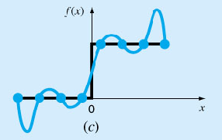
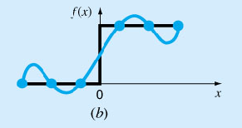
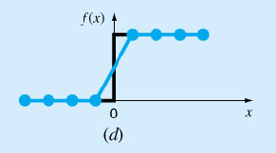
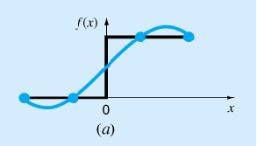
Una representación visual de una situación en la que los trazadores son mejores que los polinomios de interpolación de grado superior. La función que se ajusta presenta un incremento súbito en x = 0. Los incisos a) a c) indican que el cambio abrupto induce oscilaciones en los polinomios de interpolación. En contraste, como se limitan a curvas de tercer grado con transiciones suaves, un trazador lineal d) ofrece una aproximación mucho más aceptable.

Slide 11
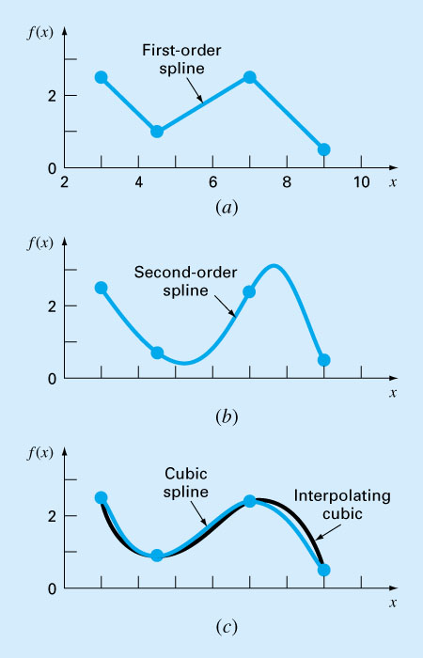
Spline Interpolation
The concept of spline is using a thin , flexible strip (called a spline) to draw smooth curves through a set of points.

Slide 12
Linear Spline
The first order splines for a group of ordered data points can be defined as a set of linear functions:

Slide 13
Linear spline - Example
Fit the following data with first order splines. Evaluate the function at x = 5.
x f(x)
3.0 2.5
4.5 1.0
7.0 2.5
9.0 0.5

Slide 14
Linear Spline
The main disadvantage of linear spline is that they are not smooth. The data points where 2 splines meets called (a knot), the changes abruptly.
The first derivative of the function is discontinuous at these points.
Using higher order polynomial splines ensure smoothness at the knots by equating derivatives at these points.

Slide 15
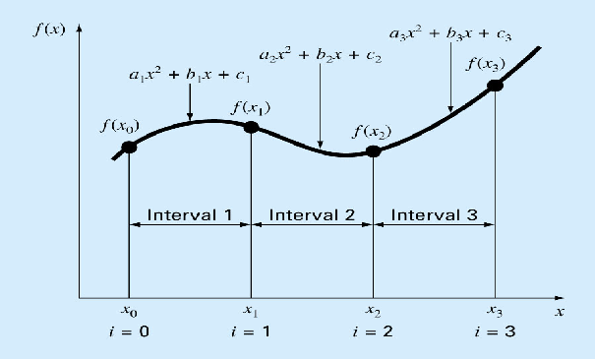
Quadric Splines
Objective: to derive a second order polynomial for each interval between data points.
Terms: Interior knots and end points
For n+1 data points:
i = (0, 1, 2, …n),
n intervals,
3n unknown constants (a’s, b’s and c’s)

Slide 16
Quadric Splines
The function values of adjacent polynomial must be equal at the interior knots 2(n-1).
The first and last functions must pass through the end points (2).

Slide 17
Quadric Splines
The first derivatives at the interior knots must be equal (n-1).
Assume that the second derivate is zero at the first point (1)
(The first two points will be connected by a straight line)

Slide 18
Quadric Splines - Example
Fit the following data with quadratic splines. Estimate the value at x = 5.
Solutions:
There are 3 intervals (n=3), 9 unknowns.
x | 3.0 | 4.5 | 7.0 | 9.0
f(x) | 2.5 | 1.0 | 2.5 | 0.5

Slide 19
Quadric Splines - Example
Equal interior points:
For first interior point (4.5, 1.0)
The 1st equation:
The 2nd equation:

Slide 20
Quadric Splines - Example
For second interior point (7.0, 2.5)
The 3rd equation:
The 4th equation:

Slide 21
Quadric Splines - Example
First and last functions pass the end points
For the start point (3.0, 2.5)
For the end point (9, 0.5)

Slide 22
Quadric Splines - Example
Equal derivatives at the interior knots.
For first interior point (4.5, 1.0)
For second interior point (7.0, 2.5)
Second derivative at the first point is 0

Slide 23
Quadric Splines - Example

Slide 24
Quadric Splines - Example
Solving these 8 equations with 8 unknowns

Slide 25
Cubic Splines
Objective: to derive a third order polynomial for each interval between data points.
Terms: Interior knots and end points
For n+1 data points:
i = (0, 1, 2, …n),
n intervals,
4n unknown constants (a’s, b’s ,c’s and d’s)

Slide 26
Cubic Splines
The function values must be equal at the interior knots (2n-2).
The first and last functions must pass through the end points (2).
The first derivatives at the interior knots must be equal (n-1).
The second derivatives at the interior knots must be equal (n-1).
The second derivatives at the end knots are zero (2), (the 2nd derivative function becomes a straight line at the end points)

